Slide 1

Data diodes for secure Industry 4.0 networking: A railway monitoring use case
Relatore: Prof. Carlo Giannelli
Correlatore: Ing. Roberto Giansante
Laureando: Cervone Giuseppe (134373)

Slide 2
Table of Contents
Industry 4.0
Disserting Alstom
The solution explained

Slide 3
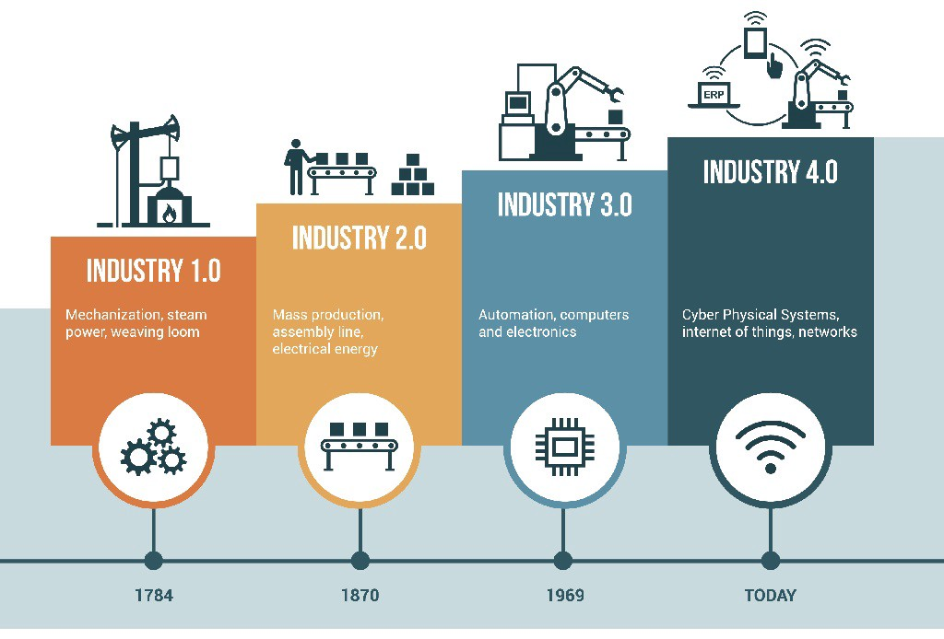
Industry 4.0
Fourth Industrial revolution.
Hannover Fair in Germany in 2011.
Set of investments suggested to the German Government by an external committee.
Similar initiatives quickly stemmed in the rest of the world.
Notes:
Us and Russia

Slide 4
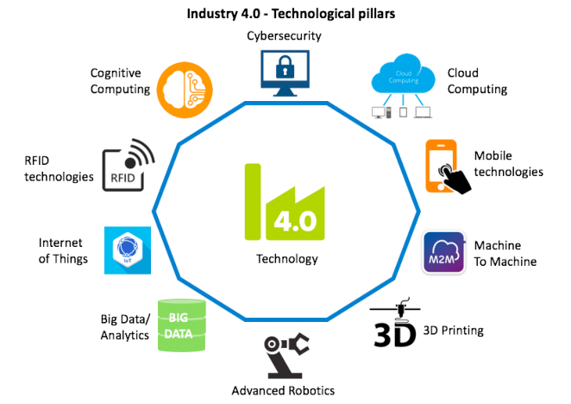
Industry 4.0 enabling technologies
Defined by the Boston Consulting Group in 2015.
Improvements in fields such as:
Industrial Internet of Things.
Cyber security.
Notes:
What helped cement industry 4.0 as a time period

Slide 5
Industrial IoT
Kevin Ashton in 1999 for Procter and Gamble.
People are provider of information in a network with device interaction.
Natural limitations in ability of humans to capture information, human error.
Allow machines to capture information on themselves and their environment.
Notes:
First mention of Industrial IoT, evolution to what IoT is more commonly seen as

Slide 6
Cybersecurity
Protection of computer systems and networks from information disclosure, theft, or damage.
Cybersecurity as an afterthought.
Software and hardware solutions
Notes:
Small mention on iot in the modern household then move on to Cybersec, Data diodes

Slide 7
Industry 4.0
Disserting Alstom
The solution explained

Slide 8

Disserting ALSTOM
French multinational company.
Market leader in the railway industry.

Slide 9

Alstom in Italy
Acquisition of Fiat Ferroviaria in the 2000s.
Two main high competence locations:
Savigliano (CN) production plant.
ALSTOM Service Signaling in Bologna.
Notes:
The acquisition of Fiat Ferroviaria cements them as one of the main clients in the Italian railway market.

Slide 10
Alstom Control Room
Monitoring and tech support.
Monitoring currently handled by mostly proprietary pieces.
Device -> Servers -> Control Room
Prevention and cure.
Control Room in support of a 3-tier help desk structure.
Tier 1: Remote diagnosing of problems.
Tier 2: Help desk remotely and on site.
Tier 3: Bugfixing.
Notes:
Explanation on their support structure

Slide 11
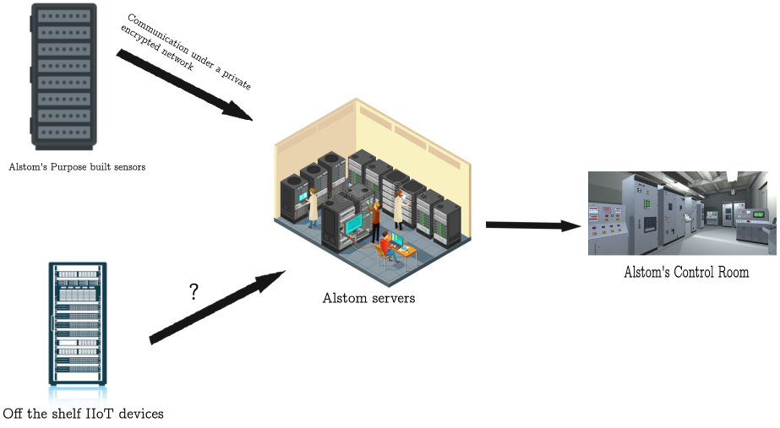
Internship explained
Notes:
What I will build

Slide 12
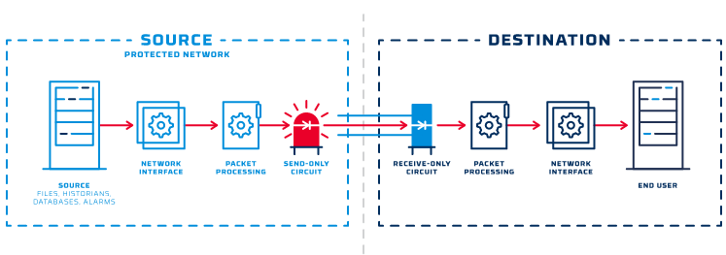
Data diodes
Hardware solution for unilateral communication.
Pros:
Hardware coded, one way, secure communication.
Can be used in a two way scenario.
Cons:
Cost of implementation.

Slide 13
Industry 4.0
Disserting Alstom
The solution explained
Notes:
Mentions on industry 4.0, periodization

Slide 14
The solution explained
Hardware.
Software.
Notes:
In two steps

Slide 15
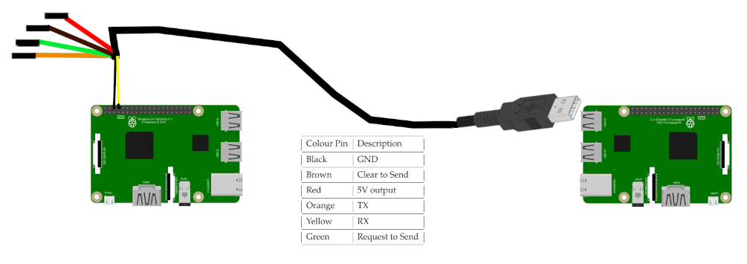
Hardware
RS-232 compliant serial cable.
Raspberry Pi 3.

Slide 16

Software
Python.
Cron.
Network monitoring software.

Slide 17

Network monitoring software comparison
Zabbix, Nagios and Cacti were three main contenders.
Cacti oldest of the contenders. Less modern feature set.
Zabbix at the time of creation biggest customer support.
Notes:
Very similar feature set, choice had to be made on smallest differences

Slide 18
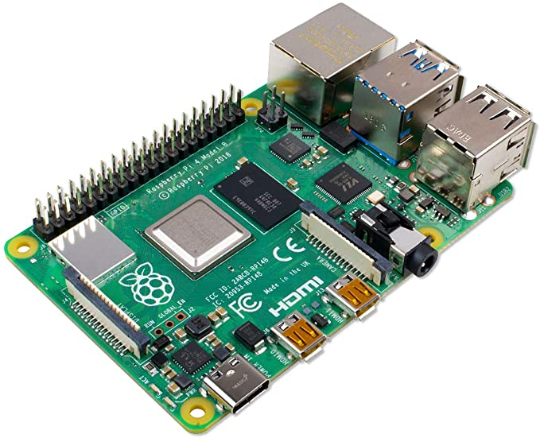

Software diagram
Private network
Sensors
Public network
On boot:
Zabbix.
On boot:
Zabbix.
cron opens rcv.py.
Data diode
At a 5 minute interval:
cron opens snd.py.
snd.py pulls data via Zabbix API.
snd.py sends data.
Upon receiving data:
rcv.py receives data.
rcv.py calls zabbix_sender.
Zabbix is updated.

Slide 19
Conclusion
System working at the time of writing, with plausible improvements.
3mb file in less than 5 minutes, single threaded mode.
Automating further setup.
Different cabling options.

Slide 20
Thank you for your attention

